Slide 1
Jquery methods
C273 – Advanced Web Application Development in PHP

Slide 2
jQuery HTML/CSS methods
Method | Description
addClass() | Adds one or more class names to selected elements
append() | Inserts content at the end of selected elements
css() | Sets or returns one or more style properties for selected elements
html() | Sets or returns the content of selected elements
prepend() | Inserts content at the beginning of selected elements
removeClass() | Removes one or more classes from selected elements
text() | Sets or returns the text content of selected elements
toggleClass() | Toggles between adding/removing one or more classes from selected elements
val() | Sets or returns the value attribute of the selected elements (for form elements)
http://www.w3schools.com/jquery/jquery_ref_html.asp

Slide 3
JavaScript syntax
Create a variable with the var statement
var length = 16; lastName = "Johnson";
var cars = ["Saab", "Volvo", "BMW"];
Arithmetic operators
 +, -, *, /, %, ++, --
Assignment operators
 =, +=, -=, *=, /=, %=
String operators
var txt1 = “John”; var txt2 = “Doe”;
// Number
// String
// Array
Operator | Description
== | equal to
=== | equal value and equal type
!= | not equal
!== | not equal value or not equal type
> | greater than
< | less than
>= | greater than or equal to
<= | less than or equal to
var txt3 = txt1 + “ “ + txt2; //txt3 contains “John Doe” var txt4 = 4 + txt3; //txt4 contains “4 John Doe”

Slide 4

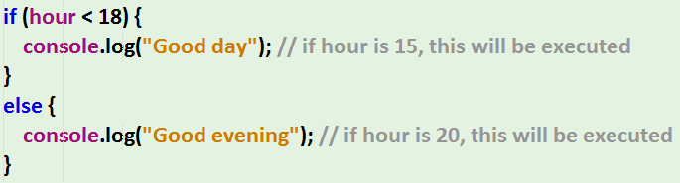
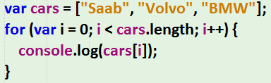
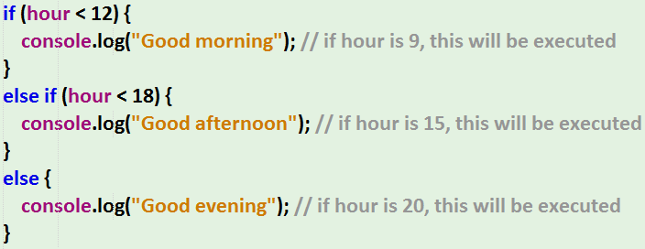
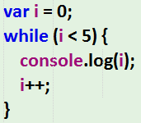
JavaScript Syntax

Slide 5
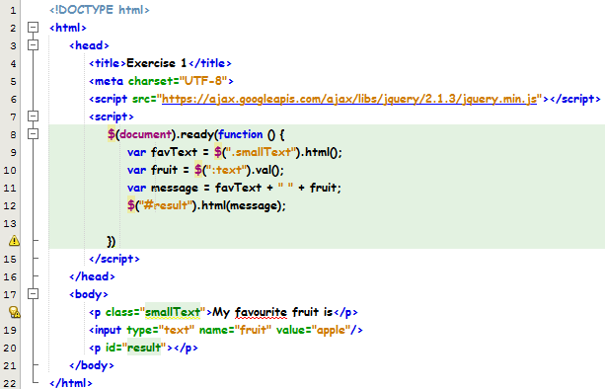
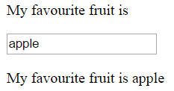
Exercise 1
Put in link to jQuery CDN
html() method is used to retrieve the HTML contents of that selector
val() method is used to retrieve the value of that form element
html() method is used to set the content of that element with the value in variable “message”

Slide 6
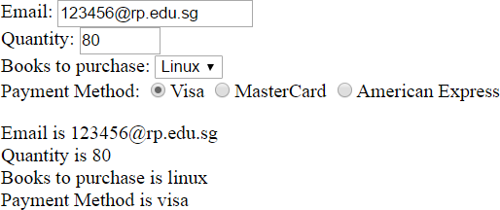
Exercise 2

Slide 7

Exercise 2 - solution
$(document).ready(function () {
var email = $("[name=email]").val();
var qty = $("[name=qty]").val(); var bookName = $("select").val();
var payment = $(":radio:checked").val(); var message = "";
message += “Email is " + email + " <br/>"; message += “Quantity is " + qty + " <br/>";
message += “Book to purchase is " + bookName + " <br/>"; message += “Payment Method is " + payment + " <br/>";
$("#result").html(message);
})

Slide 8
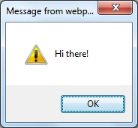
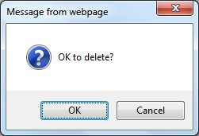
JavaScript Popup boxes
Alert box
alert(“Hi there!")
Confirm box
confirm(“OK to delete?")

Slide 9
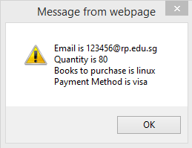

Exercise 2 - continuation
$(document).ready(function () {
var email = $("[name=email]").val();
var qty = $("[name=qty]").val(); var bookName = $("select").val();
var payment = $(":radio:checked").val(); var message = "";
message += $("[for=idEmail]").html() + " is " + email + " \n"; message += $("[for=idQty]").html() + " is " + qty + " \n";
message += $("[for=idBookName]").html() + " is " + bookName + " \n"; message += $("label:eq(3)").html() + " is " + payment + " \n"; alert(message);
})

Slide 10
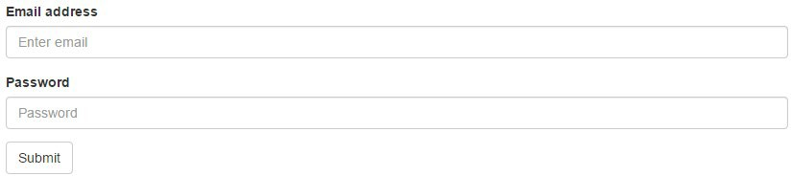
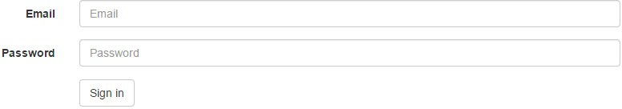
Bootstrap Forms
Vertical form
Inline form
Horizontal form

Slide 11
Basic BootstrapForm
<form method="post" action="submit.php">
<div class="form-group">
<label for="id_name">Name:</label>
<input type="text" name="myName" id="id_name" class="form-control"/>
</div>
<div class="form-group">
<label for="id_age">Age</label>
<input type="text" name="myAge" id="id_age" class="form-control"/>
</div>
<input class="btn btn-primary" type="submit" value="Calculate" />
</form>

Slide 12
Putting jQuery code in external Javascript File
Scripts can be provided locally or remotely accessible JavaScript file using src attribute.
<html>
<head>
<script src=http://somesite/hello.js />
<script src=“js/hello2.js"/>

Slide 13
Advantages of external JavaScript
Access the same script from many different webpages
An external code can be reused by many applications.
Single source to avoid different versions of the script in different files.
The script file is cached once downloaded which means that the script does not need to be downloaded separately as part of every Web page

Slide 14
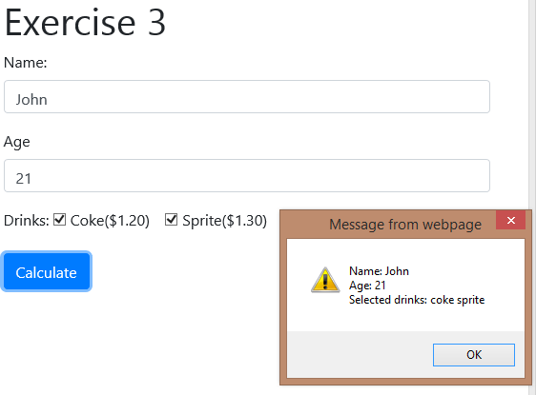
Exercise 3

Slide 15

Exercise 3 - solution
<link href="css/bootstrap.min.css" rel="stylesheet" type="text/css"/>
<script src="https://ajax.googleapis.com/ajax/libs/jquery/3.4.1/jquery.min.js"></script>
<script src="js/exercise3.js" type="text/javascript"></script>
$(document).ready(function () {
$("form").submit(function () {
var name = $("#id_name").val(); var age = $("#id_age").val();
var message = "";
message += "Name: " + name + "\n"; message += "Age: " + age + "\n";
The submit event occurs when a form is submitted. This event can only be used on
<form> elements

Slide 16

Exercise 3 - solution
This selector retrieves all selected
message += "Selected drinks: "; var cost = 0;
checkboxes. The each() function is used to iterate every selected checkbox
$("[type=checkbox]:checked").each(function () {
var drink = $(this).val();
message += drink + " ";
$(this) selector retrieves the current
element of the iteration
if (drink == "coke") { cost += 1.2;
} else if (drink == "sprite") { cost += 1.3;
} else {
cost += 1.4;
}
The toFixed() method converts a
number into a string, keeping a specified
number of decimals.
})
message += "\n\n The total cost is $"+cost.toFixed(2); alert(message);
return false;//don't submit the form
})
});

Slide 17
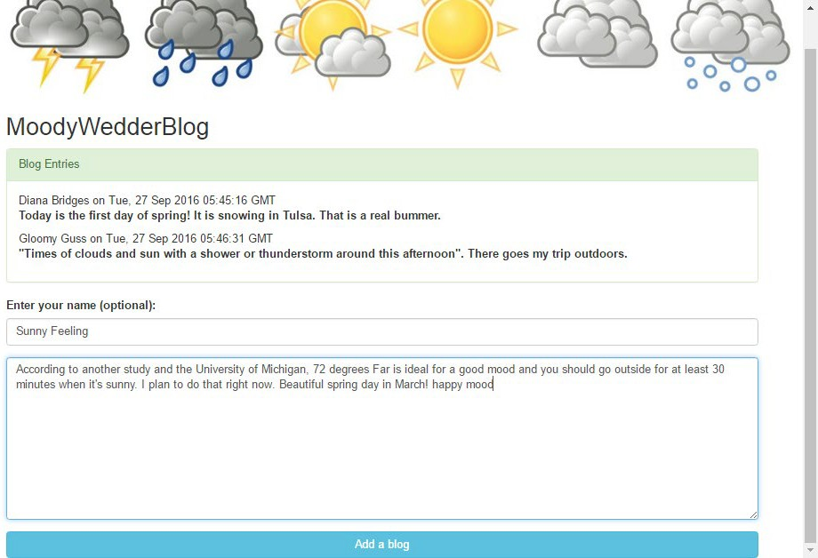
Exercise 4
Enter your name and blog content, click on the button and the entries get appended into the panel

Slide 18
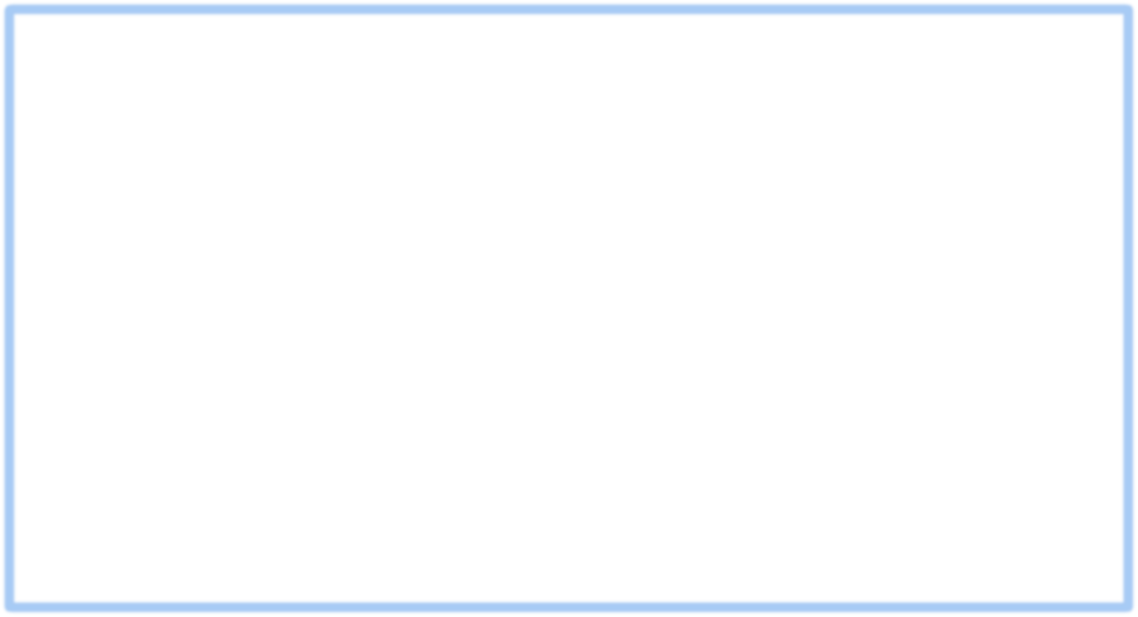
Exercise 4 - solution
$(document).ready(function () {
$("#blogform").submit(function (evt) { var currDate = new Date();
var name = $("#name").val();
var blog = $("#blog").val();
retrieve the current date time
var message = "<p>" + name + " on " + currDate.toUTCString() + "<br/><b>" + blog + "</b></p>";
$(".card-body").append(message);
$("#name").val("");
$("#blog").val(""); return false;
Reset the values of both form fields
});
});

Slide 19
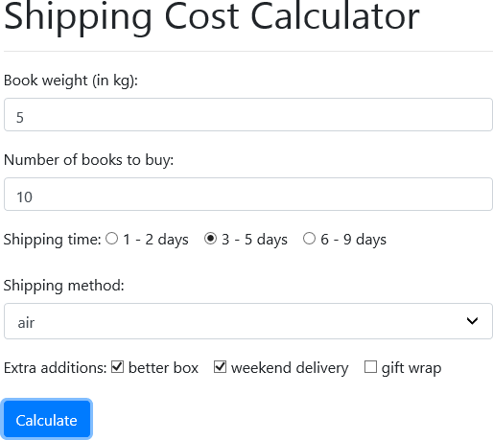
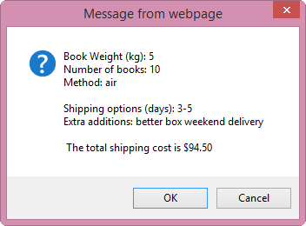
Problem 1

Slide 20

Problem 1 - solution
$(document).ready(function () {
$("form").submit(function () {
var bookWt = $("[name=bookWeight]").val(); var bookAmt = $("[name=bookAmount]").val();
var shipMtd = $("[name=shippingMethod]").val();
var shipTime = $("[name=shippingTime]:checked").val(); var message = "";
message += "Book Weight (kg): " + bookWt + "\n"; message += "Number of books: " + bookAmt + "\n"; message += "Method: " + shipMtd + "\n";
message += "Shipping options (days): " + shipTime + "\n";

Slide 21

Problem 1 - solution
//calculation of cost of total book weight var totalCost = bookWt * bookAmt * 0.5;
if (shipMtd == "air") { totalCost += 30;
} else {
totalCost += 40;
}
if (shipTime == "1-2") { totalCost += 40;
} else if (shipTime == "3-5") { totalCost += 25;
} else {
totalCost += 10;
}

Slide 22
Problem 1 - solution
message += "\nExtra additions: ";
$("[name='extra[]']:checked").each(function () { var extra = $(this).val();
message += extra + " ";
if (extra == "better box") { totalCost += 10;
} else if (extra == "weekend delivery") { totalCost += 15;
} else {
totalCost += 15;
}
});

Slide 23

Problem 1 - solution
if (bookAmt > 3) {
totalCost = totalCost * 0.9;
}
message += "\n\n The total shipping cost is $" + totalCost.toFixed(2); var strconfirm = confirm(message);
if (strconfirm == true) { return true;
} else {
return false;
}
});
});

Slide 24
JavaScript String functions
var myString = “An apple“;
Function | Usage
charAt(x) | e.g. myString.charAt(5) // returns “p”
indexOf(substr) | e.g. myString.indexOf(“apple") // returns 3
replace(substr, replacetext) | e.g. myString.replace(“apple”, “orange") // returns “An orange”
substring(from, [to]) | e.g. myString.substring(0, myString.indexOf(“ “)) // returns “An”
split(delimiter, [limit]) | e.g. var word = myString.split(“ “); word[0] // contains “An” word[1] // contains “apple”
toLowerCase(), toUpperCase() | e.g. myString.toLowerCase() // returns “an apple” e.g. myString.toUpperCase() // returns “AN APPLE”
length | e.g. myString.length // returns 8
And many more…. | http://www.w3schools.com/jsref/jsref_obj_string.asp

Slide 25
4 useful JavaScript functions
Function | Description
parseInt() | Converts a string to integer e.g. var num = “5”; num.parseInt() // returns 5
set/getDate() | Set/Get the day to/as a number (1-31)
set/getFullYear() | Set/Get the four digit year (yyyy)
set/getMonth() | Set/Get the month (0-11)
And many more…. | http://www.w3schools.com/jsref/jsref_obj_date.asp
var currentTime = new Date();
var month = currentTime.getMonth() + 1; var day = currentTime.getDate();
var year = currentTime.getFullYear(); console.log(month + "/" + day + "/" + year);

Slide 26
Summaries
Apply jQuery methods to manipulate HTML elements
Identify and use Javascript variables
Apply Control Structure (if-else statements & forloop)
Create Bootstrap forms
Display alert and confirm boxes
Apply String functions indexOf(), match(), substring()

